Slide 1


TCR Data Exploration
Isaac Lee

Slide 2

Introduction :: About Me
Hi, my name is Isaac!
I’m a maths undergrad at Imperial College London.
I have a keen interest in Data Science, ML and programming.

Slide 3
Introduction :: Project Goals
Exploration
Predicting when service requests will occur
Preventative Maintenance recommendations

Slide 4
Introduction :: Steps Taken
Data extraction and cleaning
Initial exploration
Model fitting
Preventative Maintenance Recommendations

Slide 5
The Data
Combining TCR data with customer call data

Slide 6
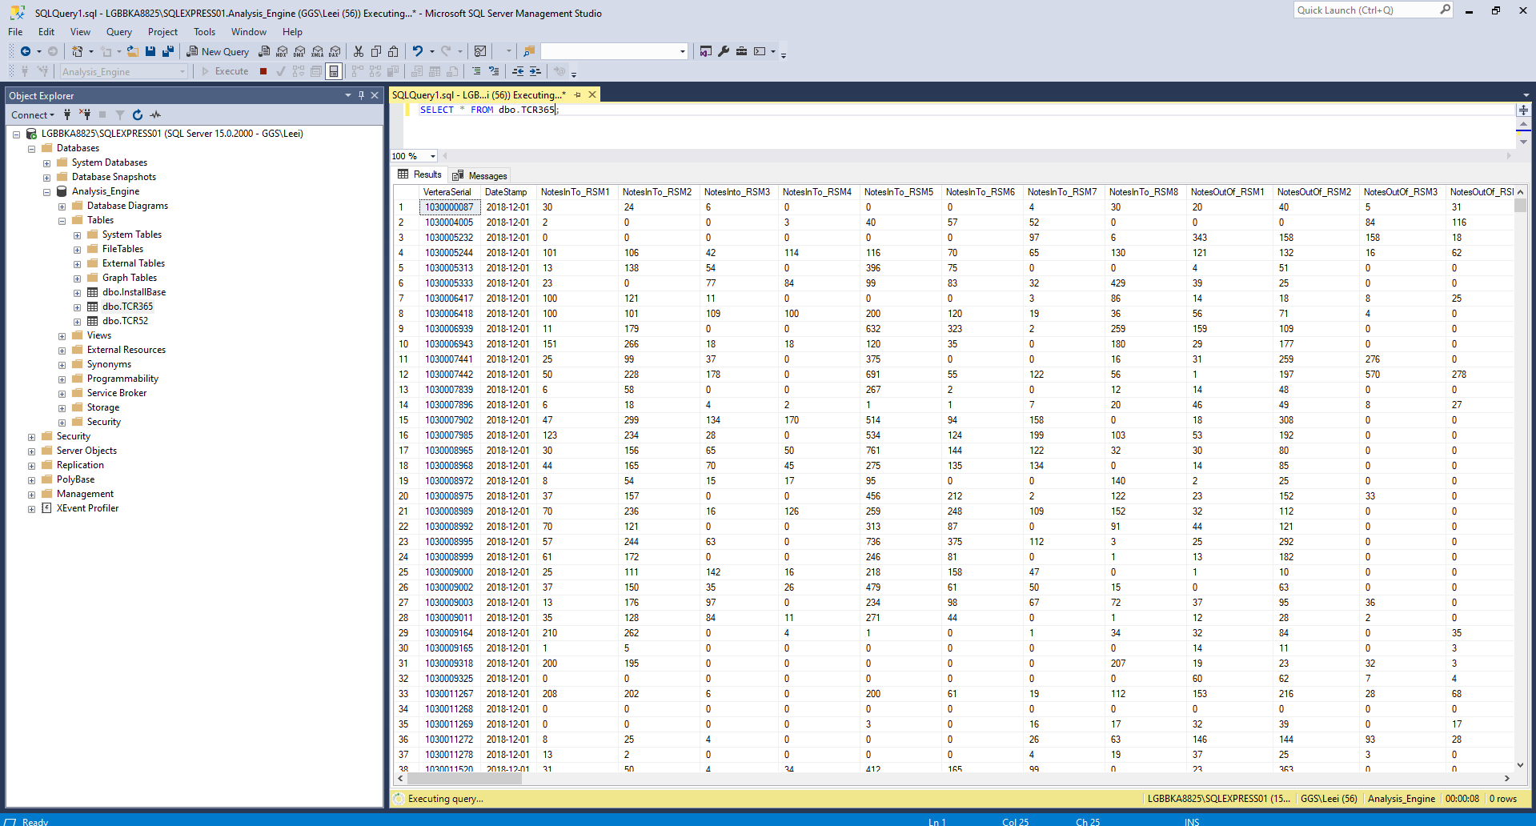
The Data :: TCR Data (from Bridge)

Slide 7
The Data :: Key Features
AutoPurgeCount
AllRejectCount
DeviceAccessErrors
CALC_TotalPaidIn
CALC_TotalPaidOut
CALC_TotalSafeMoved
CALC_TotalMovements
CALC_NotesMovedPerAutopurge
CALC_ErrorFreeMovementPercent
CALC_AcceptancePercent
CALC_CALC_SkewPercent
CALC_OverfillPercent
CALC_TotalRegressions
CALC_TotalInterruptions
FirstRegressions (First errors to occur)

Slide 8
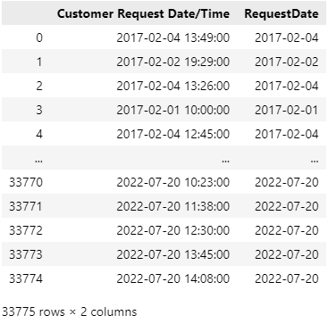
The Data :: Call Data (from Echo)

Slide 9
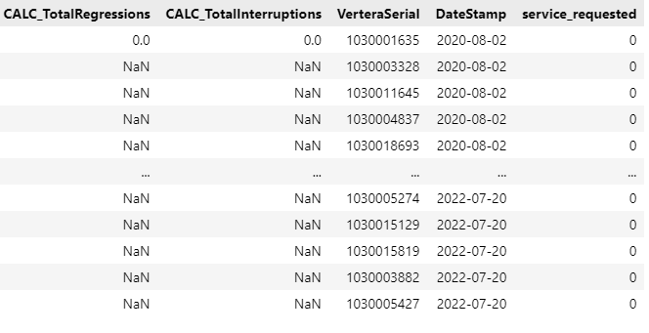
The Data :: Combined Data
Add service_requested
Add missing days

Slide 10
Visualisations
Can we spot any obvious trends?

Slide 11
Visualisations :: All features

Slide 12
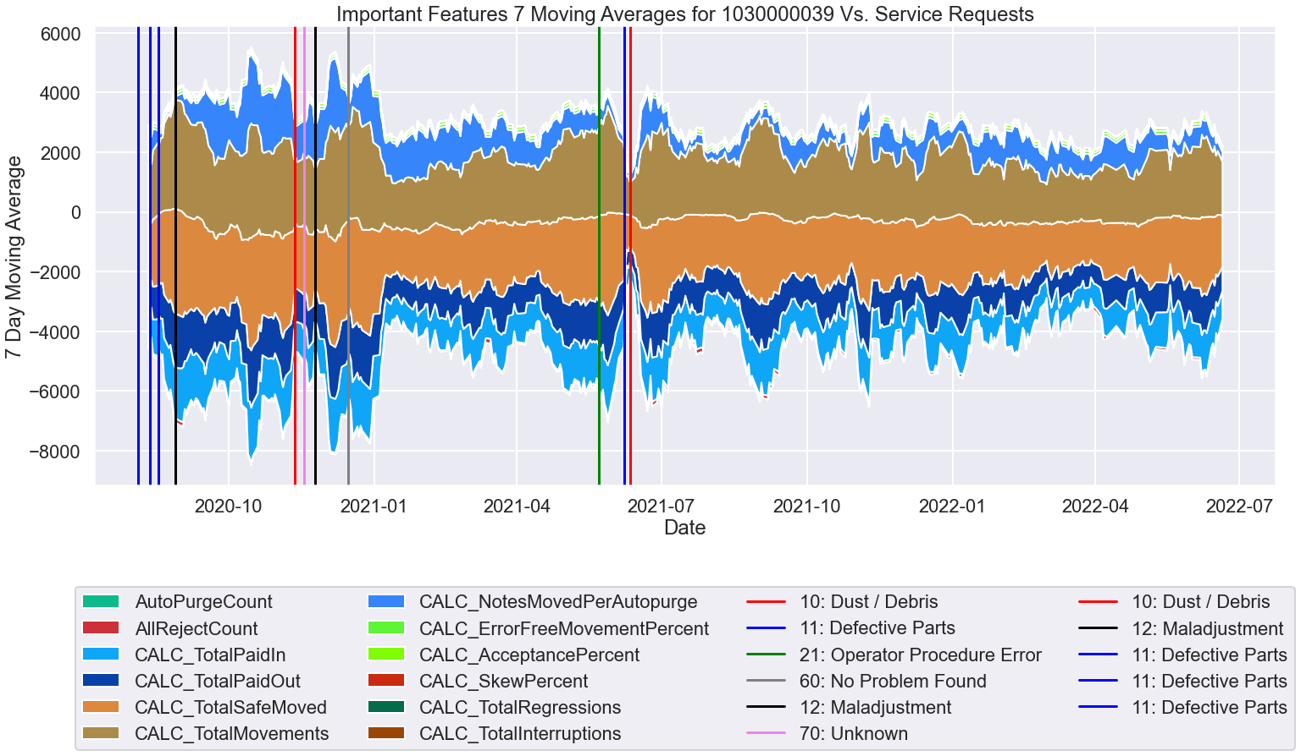

Slide 13
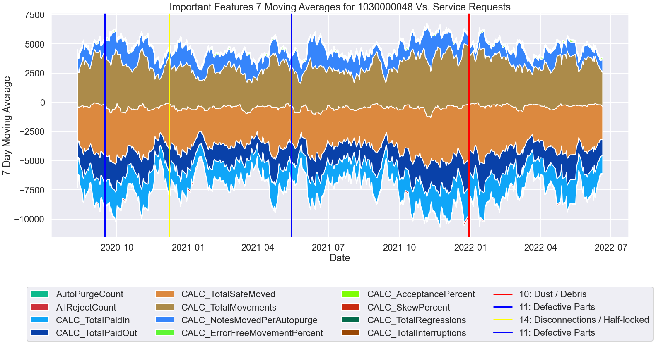

Slide 14
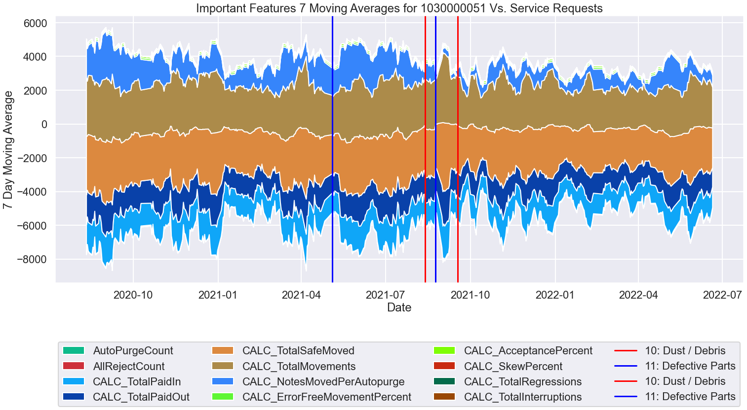

Slide 15
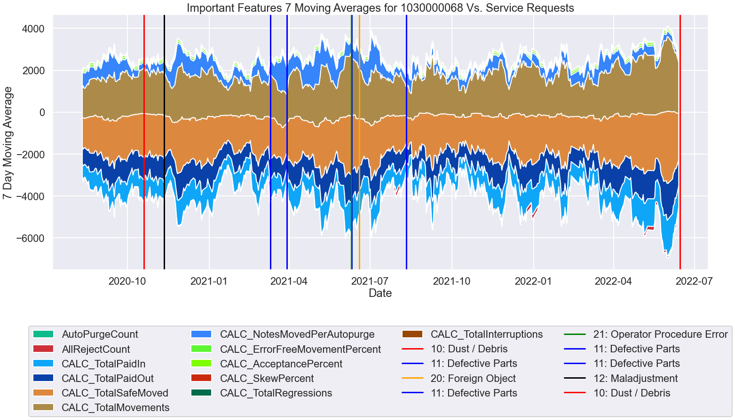

Slide 16
Visualisations :: Conclusion
No obvious link between usage and when a service request occurs.

Slide 17
Visualisations :: Requests Vs. Totals

Slide 18
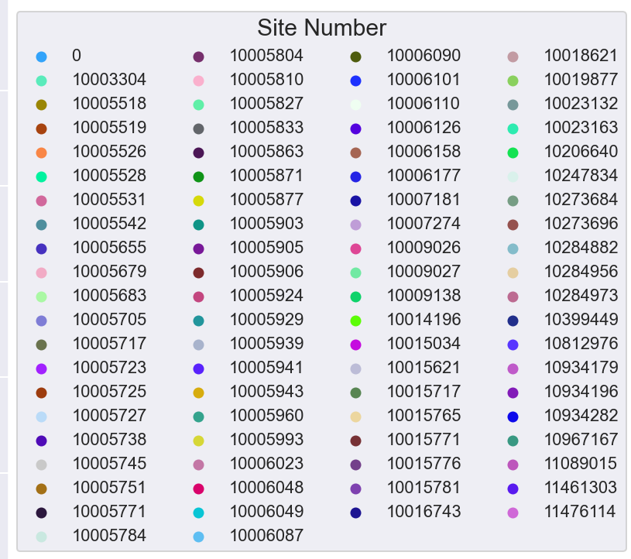

Slide 19
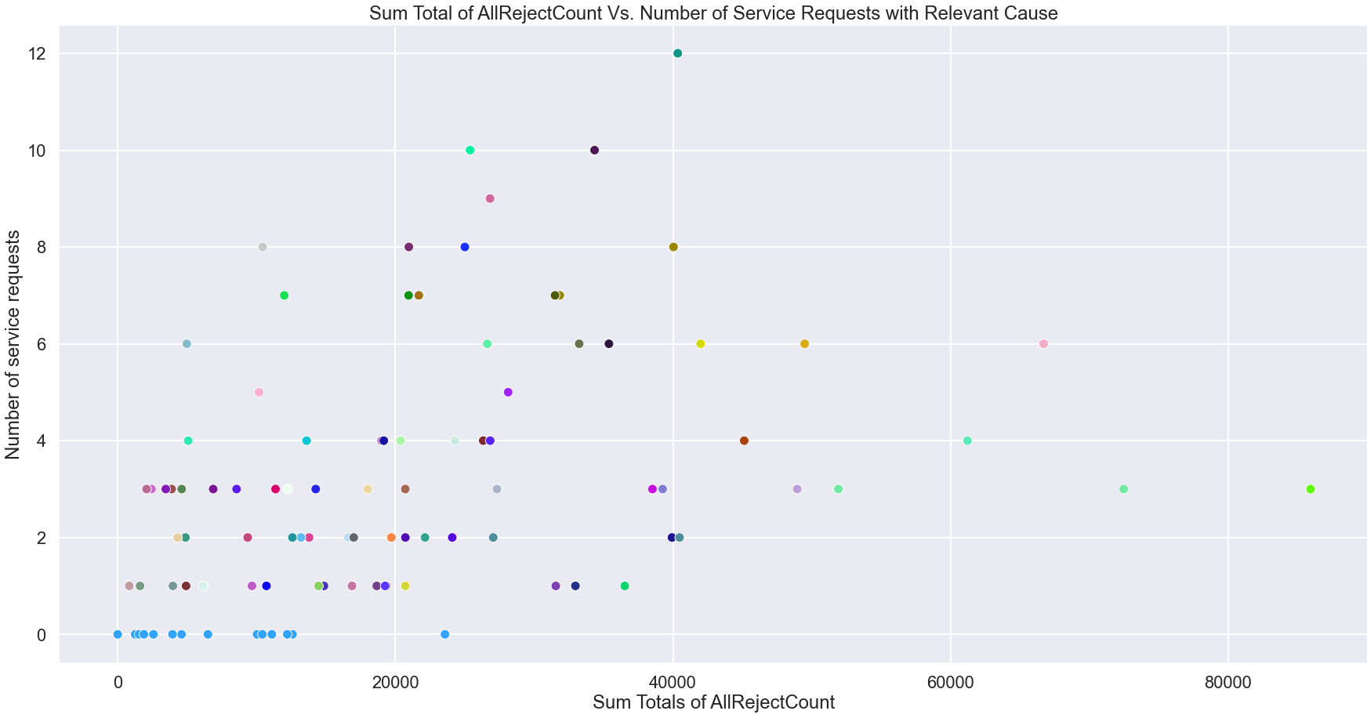

Slide 20
Visualisations :: Conclusion
Note: Site number = 0 when site data is missing.
Different colours represent different sites/locations.
Location doesn’t seem to have any effect.
Weak positive trend shows weak correlation between usage and number of services.

Slide 21
Visualisations :: Sum Between Services

Slide 22
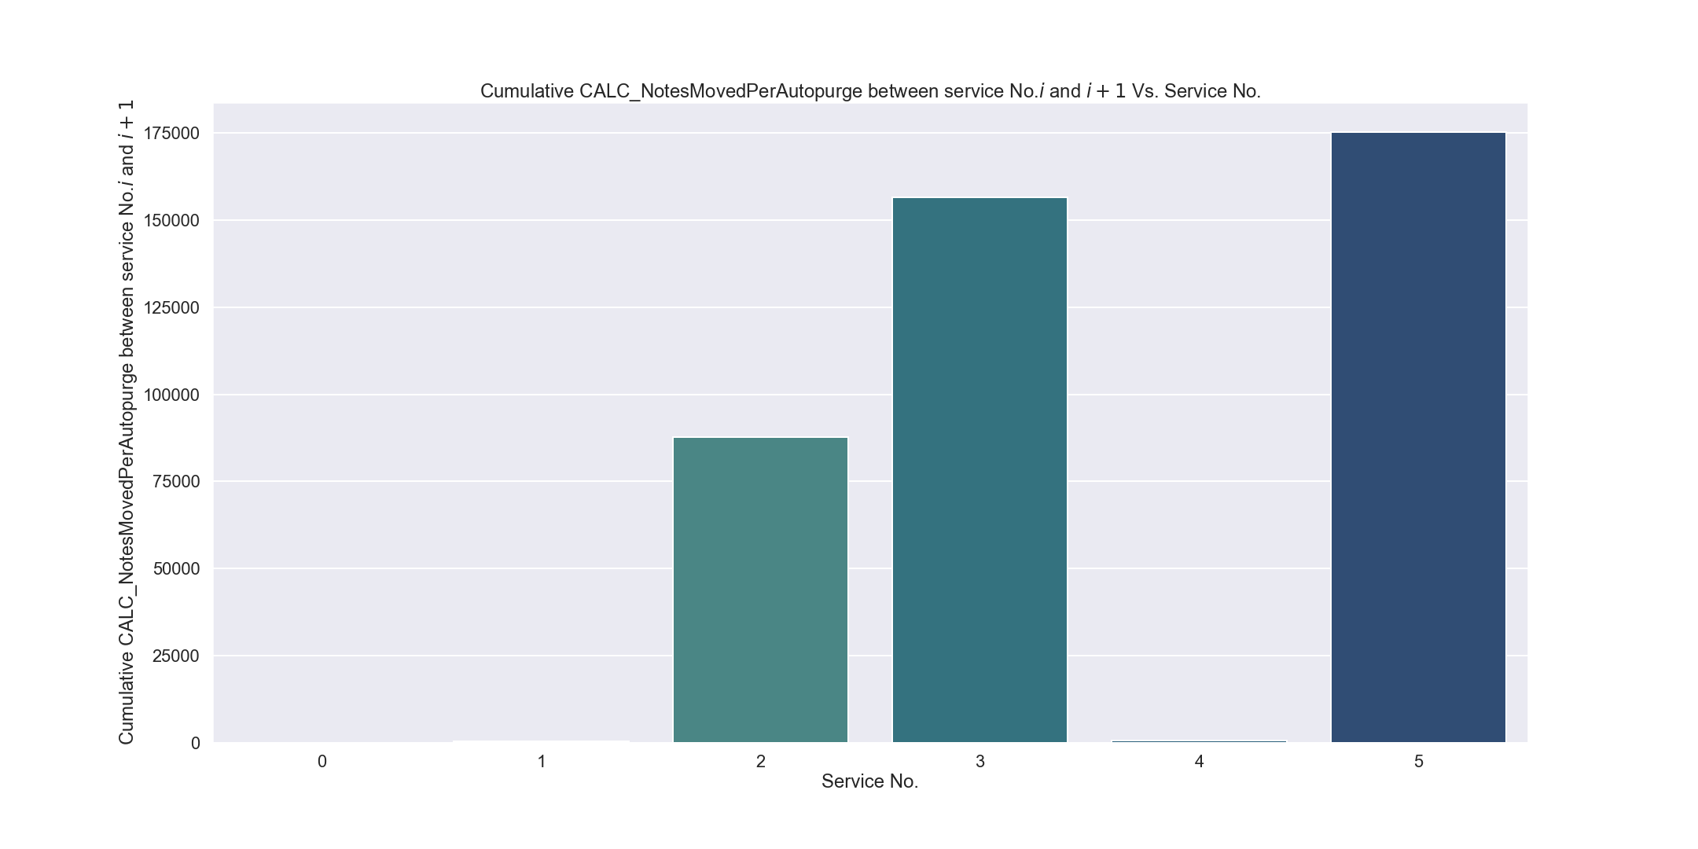
(We would expect this to be decreasing with age)

Slide 23
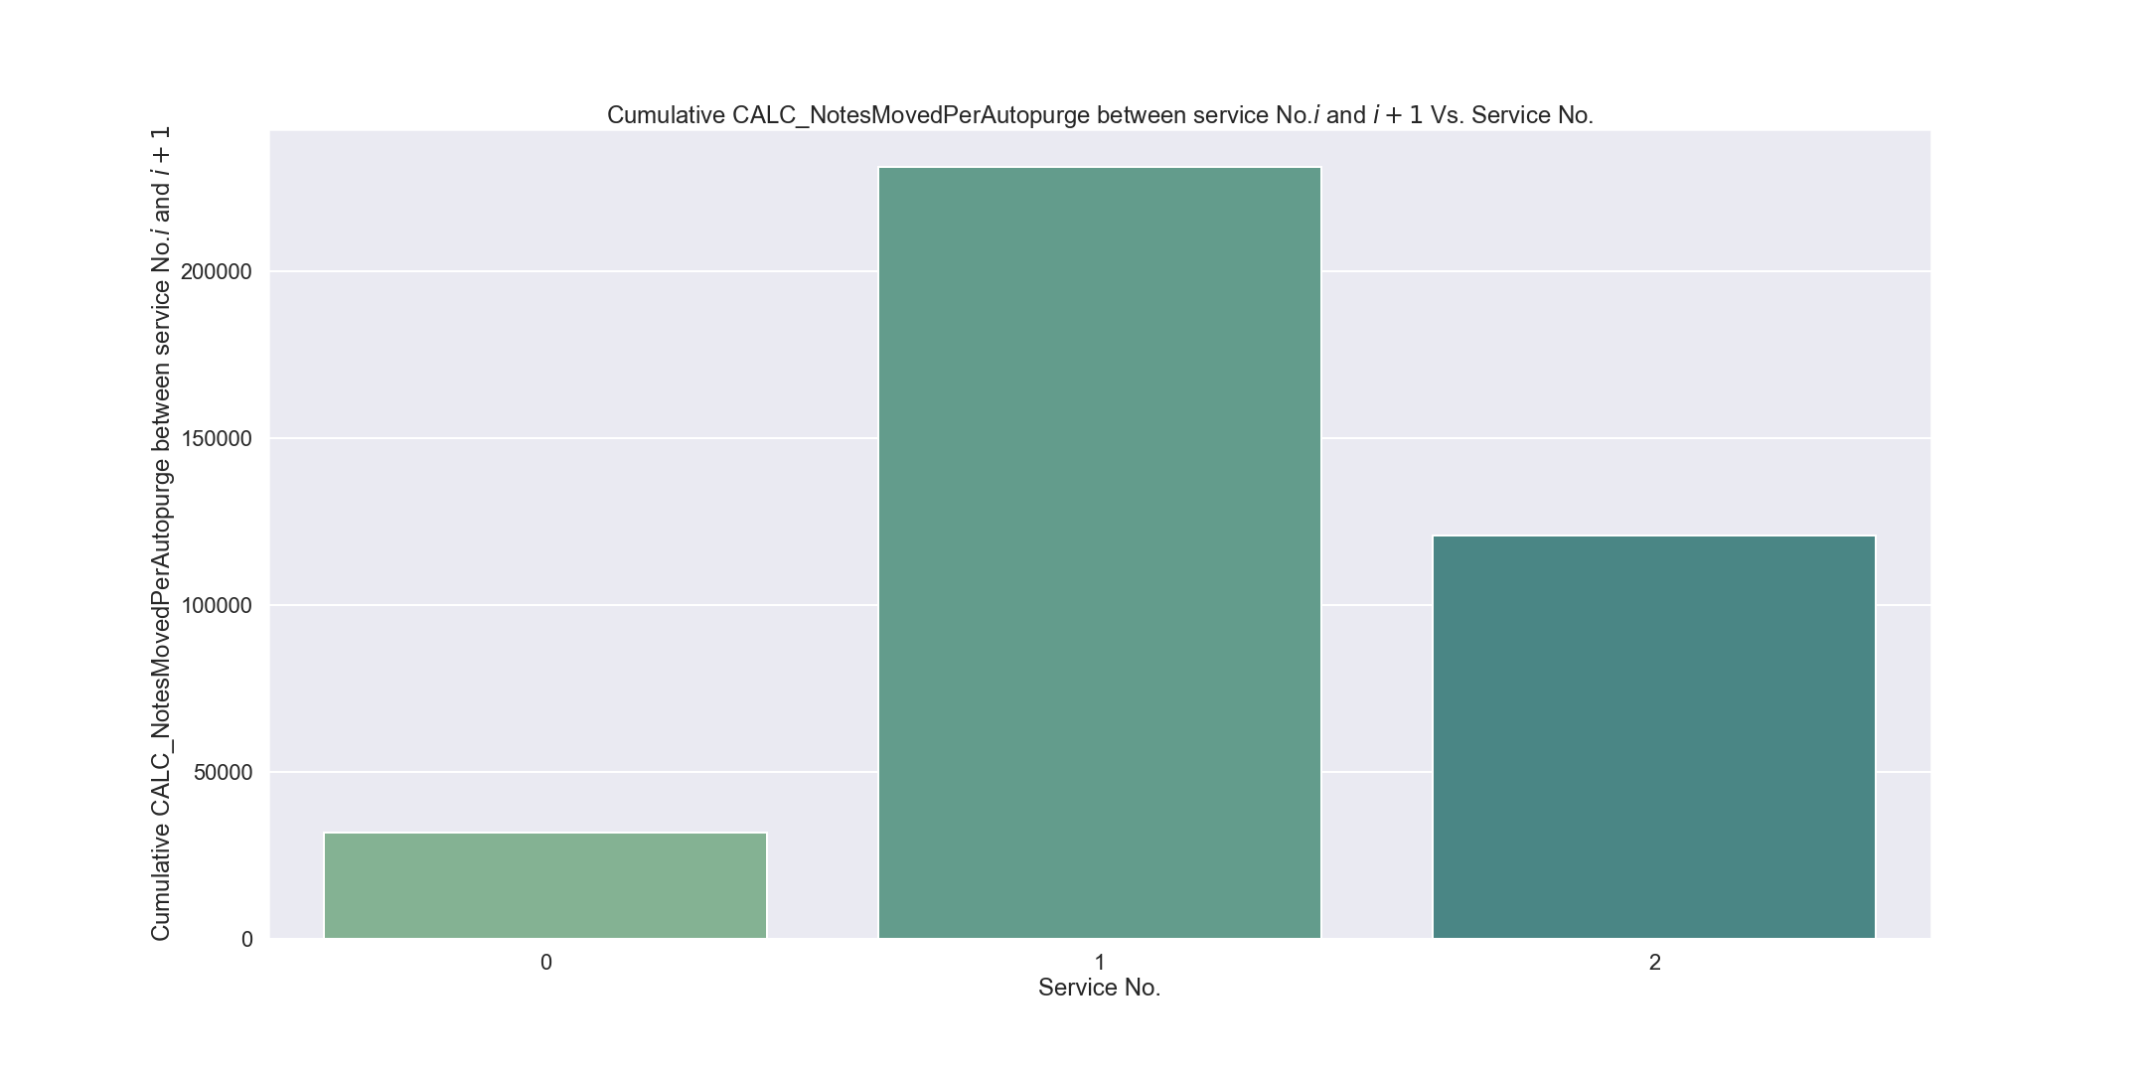

Slide 24
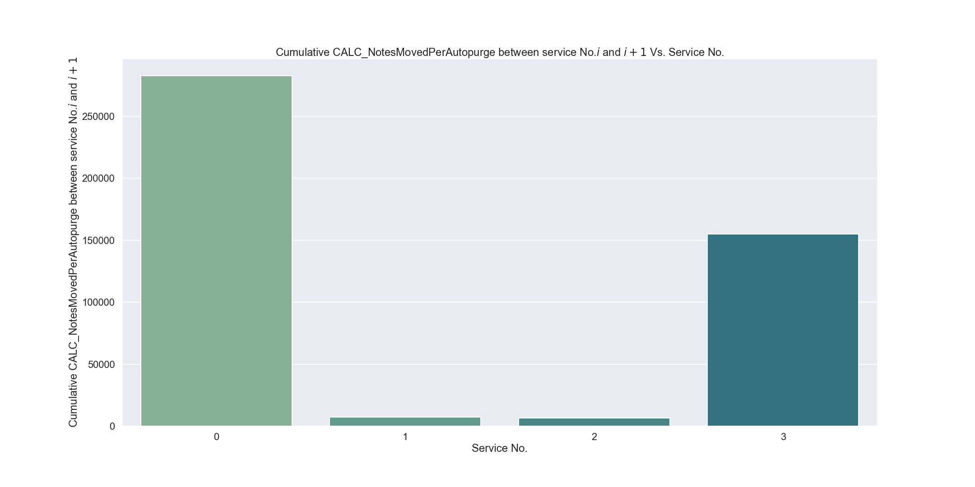

Slide 25
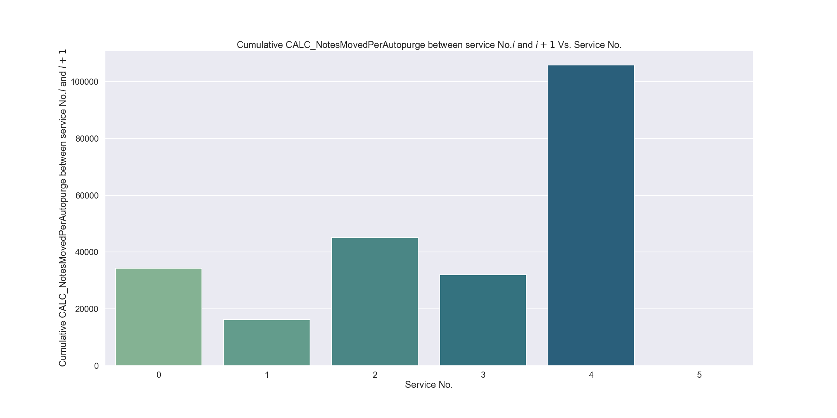

Slide 26
Visualisations :: Conclusion
The ith bar represents the sum of the feature between services i and i + 1.
If more usage means increased chance of a service, we would expect this to show a downtrend with age.
Clearly not the case. More evidence that more usage does not necessarily mean increased chance of a service.

Slide 27
Visualizations :: Moving Averages

Slide 28
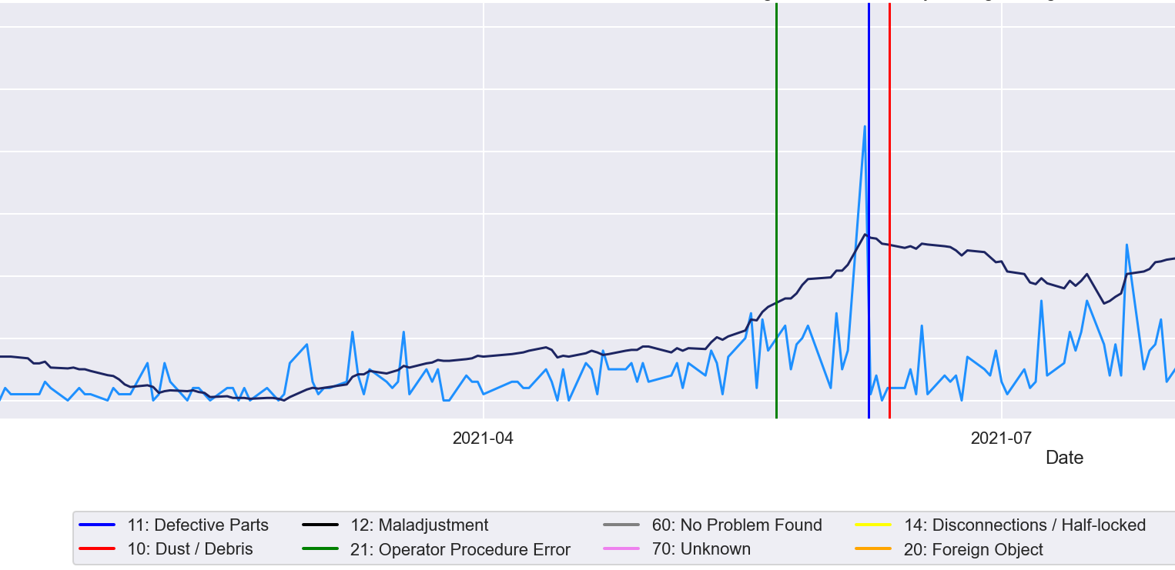

Slide 29
Visualisations :: Conclusion
Moving averages “smooth” out the data and remove some of the more erratic values.
Useful for spotting overall trends.
Vertical lines represent a service, colour coded by error cause.
Light blue line represents daily values.
Dark blue line represents 30 day moving average.

Slide 30
(M)oving (A)verages
Does a feature breaking above/below its moving average give us an indication of when a service request will occur?

Slide 31
MA :: Basic Idea
Perhaps certain features breaking their moving averages is a good indicator that a service will soon be requested?
Interactive dashboard link: https://glory-dash-app.herokuapp.com/

Slide 32
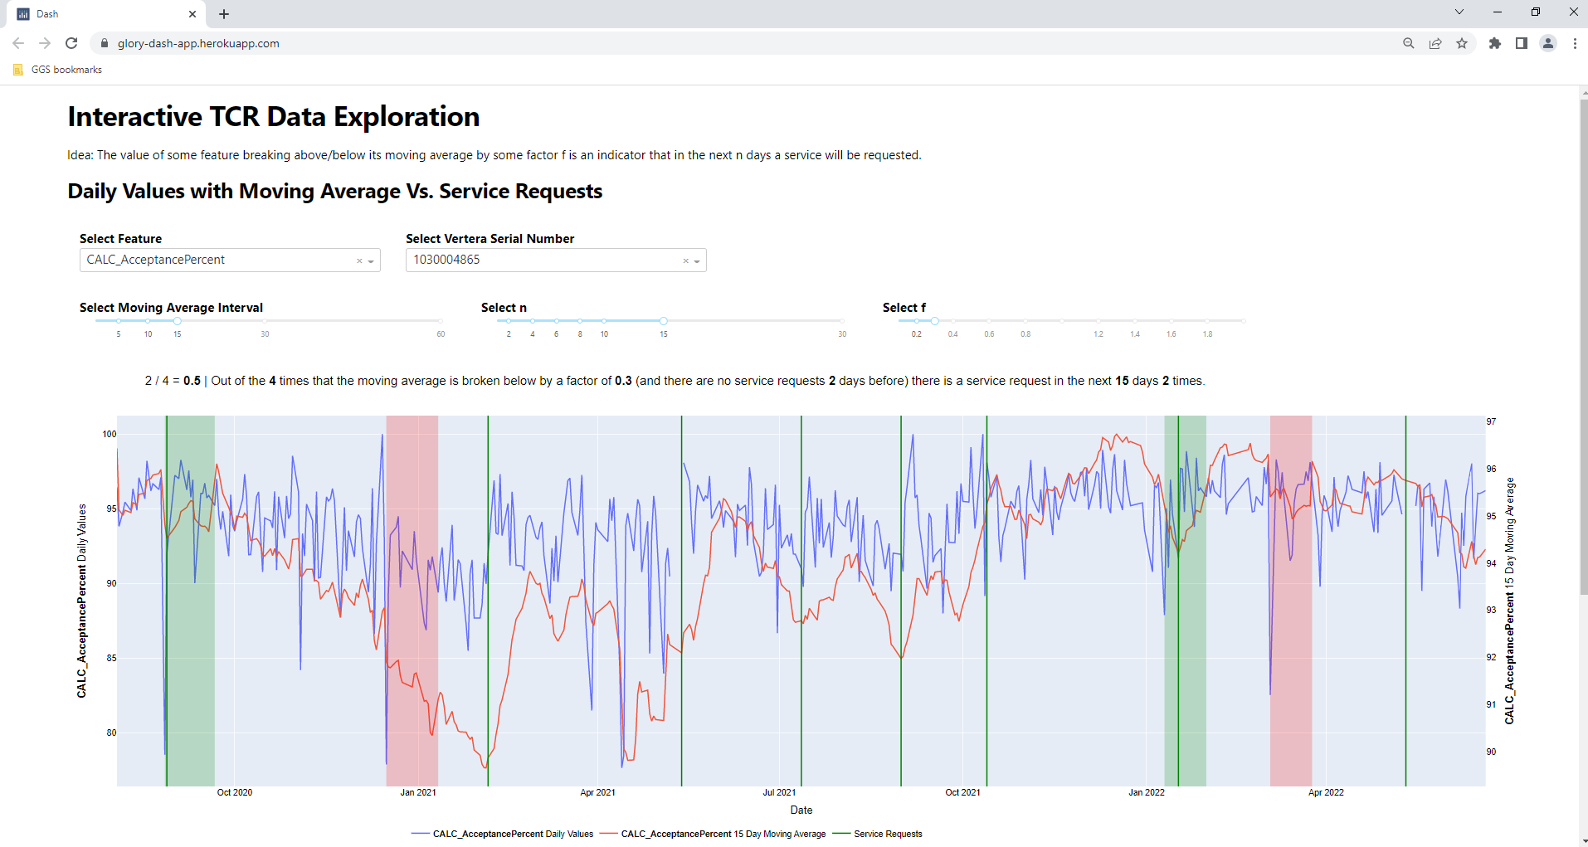

Slide 33
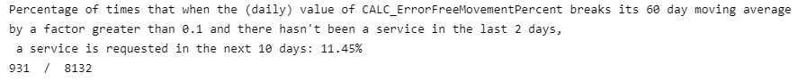
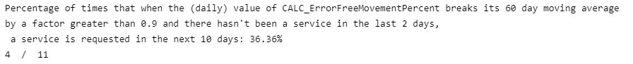
MA :: Results
We would expect these percentages to be much higher if an increase in usage is linked with increased chance of a service.
Same story for other features.
Perhaps not so useful...

Slide 34
(M)achine (L)earning
Can we use machine learning techniques to build a model that will predict when a service request will occur?

Slide 35
ML :: Supervised Learning
Definition: When we fit our model to data for which we know the outcome.
What are we predicting?
y = 1 if at least one service request occurs in the next n days.
y = 0 if no services requested in the next n days.

Slide 36
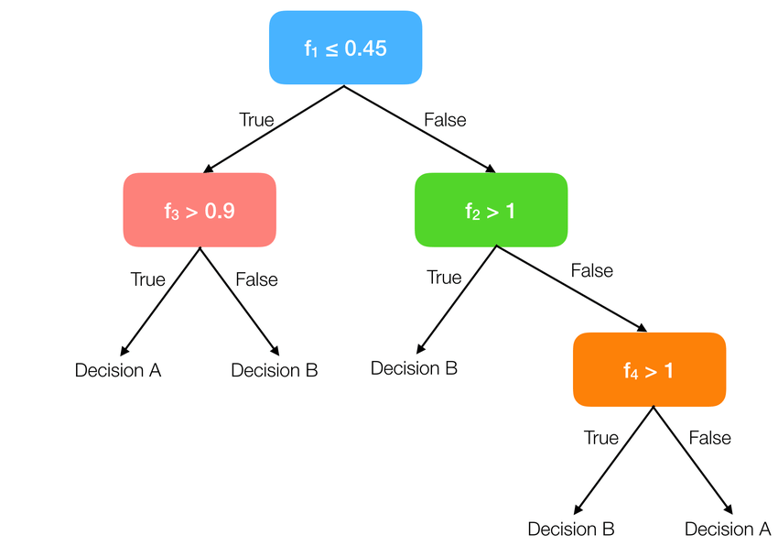
ML :: Decision Trees
Makes a sorting method based on training data.
Good at finding hard to spot patterns in data.
XGBoost + Random Forest

Slide 37
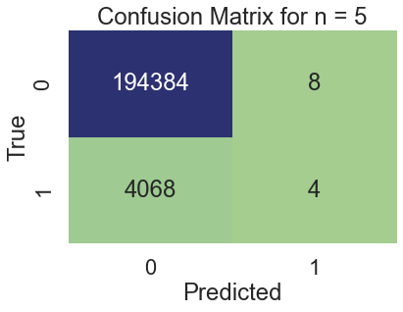
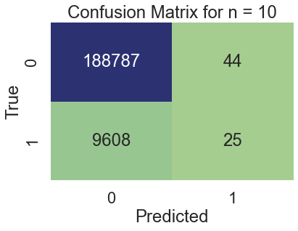
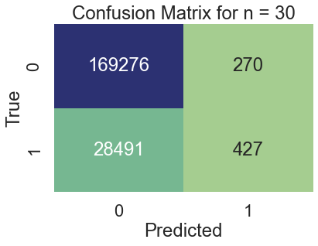
ML :: XGBoost Results
Note: Random forest results very similar

Slide 38
ML :: XGBoost Results
A “confusion matrix” displays the results of the model making predictions on the test data.
Although accuracy of models is high, because data is highly imbalanced this is not a useful metric, since we could just guess all 0s and get a high accuracy.
The actual number of 1s we correctly predict as 1 is very low, showing very poor performance.

Slide 39
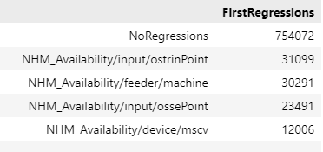
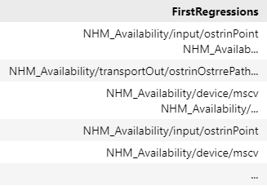
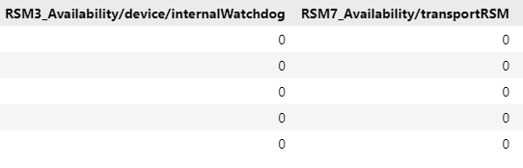
ML :: FirstRegressions

Slide 40
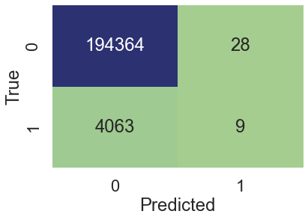

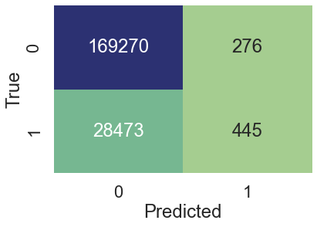
ML :: Results with FirstRegressions
n = 5
n = 10
n = 30
Note: Random forest results very similar

Slide 41
ML :: Results with FirstRegressions
Equally bad performance.

Slide 42
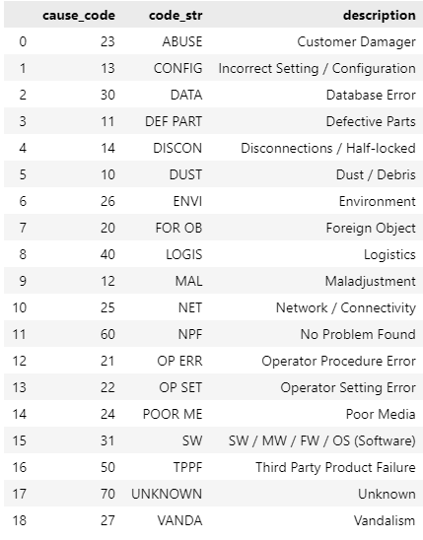
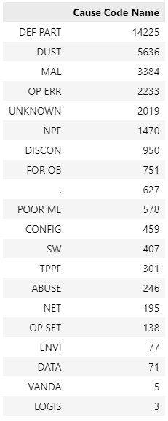
ML :: “Predictable” Services

Slide 43
ML :: “Predictable” Services
Previous slide shows cause codes with their descriptions, as well as the value counts of each cause code.
Clearly DEF PART, or defective parts and DUST are the most common cause codes.
These are also probably the only predictable errors. I.e other causes like “Vandalism” are not predictable.
We remove all non-predictable cause codes from the data and re-train our models...

Slide 44

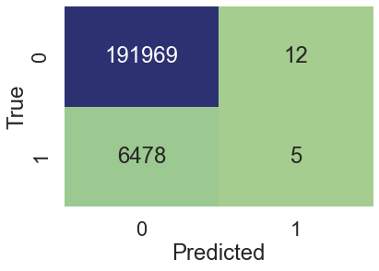
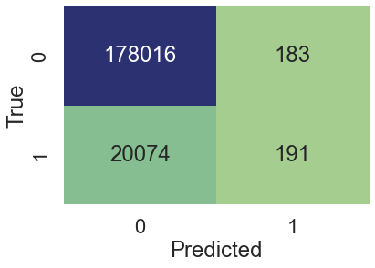
ML :: Results with “Predictable” Services
n = 5
n = 10
n = 30
Note: Random forest results very similar

Slide 45
ML :: Results with “Predictable” Services
Once again, does not perform well at all.

Slide 46
ML :: Simple Neural Network
Also tried a neural network approach
Results were even worse!

Slide 47
ML :: Conclusion
The TCR data and service requests are insufficiently correlated for this kind of modelling to be useful.
Perhaps other factors at play, such as humidity, room temperature etc.

Slide 48
(P)reventative (M)aintenance
Is the data at all useful?

Slide 49
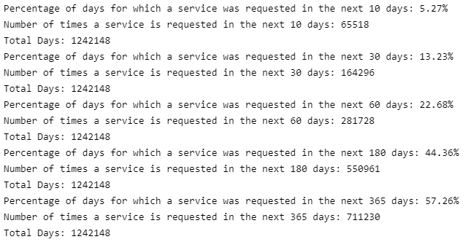
PM :: Percent Days

Slide 50
PM :: Percent Days
We can work out the percentage of days for which a service request occurs in the next n days.
Knowing this is actually very useful information because it allows us to distribute the preventative maintenances in a more intelligent way.
I.e Only send out a service every n days, such that the percentage of days for which a service request occurs in the next n days is high enough for the preventative maintenance to be “worth it”.

Slide 51
Conclusion
So, what have we learned?

Slide 52
Conclusion :: Key Takeaways
More usage does not necessarily mean increased chance of a service.
TCR Data not sufficiently correlated to be useful for prediction.
Percentage of days for which a service occurs in the next n days could be useful.

Slide 53
Conclusion :: Going Forward
More data needed, for example humidity or temperature could be additionally monitored.
Combined datasets could be useful... more work on them could be possible.
Use PM percent days data to inform decision on when PMs should be sent out.

